Slide 1
FINANCE
MMI1060
Lecturer: Tanya Kirsch
Class #3: Capital Budgeting
(Berk Ch. 8: Investment Decision Rules)

Slide 2

Key formulae (from the formula sheet)

Slide 3

Homework problem #1
…The average Canadian home sold for $386,585 in June, which means monthly payments of $1,865 if you assume a 3.39 per cent fixed five-year mortgage rate and a 5 per cent down payment. If prices fell 5 per cent and mortgage rates increased by half a percentage point, the monthly payment is pretty much the same….
https://secure.globeadvisor.com/servlet/ArticleNews/story/gam/20130716/GICARRICK0715ATL
Homework:
Prove that if prices fell by 5% and mortgage rates increased by half a % (i.e. to 3.89%), the monthly payment would be the same
Notes:
See separately posted note for workings.

Slide 4
Investment decision rules
Ch. 8

Slide 5
Objectives
Calculate Net Present Value (NPV) and Payback Period
Explain the calculation of Internal Rate of Return (IRR)
Distinguish between IRR and NPV, and interpret the results of calculations
To understand and interpret IRR:
Compare to cost of capital
Draw a basic graph of NPV profiles and show the IRR’s for two projects
Understand the NPV / IRR issues
Understand other Capital budgeting decision rules

Slide 6
In-class problem #1:
Which investment would you choose to invest in if:
Your discount rate is 10%?
Your discount rate is 15%?
 | Cost of investment | Income in year 1 | Income in year 2
Investment A | -$30,000 | $21,000 | $21,000
Investment B | -$50,000 | $33,000 | $33,000
Notes:
At 10%:
NPV A = 6,446
NPV B = 7,273 preferred
At 15%:
NPV A = 4,139 preferred
NPV b = 3.648
IRR A = 25.7%
IRR B = 20.7%
Should you invest in A or B?
B is more expensive but gives better cash flow in year 1 and year 2

Slide 7
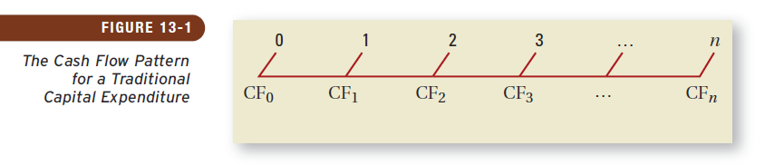
Evaluating Investment Alternatives
The diagram below shows the cash flow pattern for a traditional capital expenditure project:
Where :
CF_{t} = the estimated after-tax future incremental cash flow at time t
CF₀ = the initial after-tax incremental cash outlay
We will consider DCF methods for evaluating investment alternatives: Net Present Value (NPV) and Internal Rate of Return (IRR)
We will also consider payback period and discounted payback period
You can ignore the profitability index (PI)
Notes:
Capital means tangible assets
-

Slide 8
Net Present Value
NPV = PV of cash flows – Initial Investment
Where, C_{t} = Cash flow at time t
r = Opportunity cost of capital / Discount rate / required return

Slide 9
The 30 second summary
Notes:
http://www.huffingtonpost.com/robyn-scott/the-30-second-habit-that-_b_4808632.html

Slide 10
Problem #2: Timing of cash flows
To illustrate the impact of the timing of cashflow:
Project B receives more overall cash flow than Project A, but B receives their cash later than A
 | t = 0 | t = 1 | t = 2 | t = 3
Project A | -10,000 | 10,000 | 1,000 | 1,000
Project B | -10,000 | 1,000 | 1,000 | 12,000
Calculate the NPV of each project if the discount rate is: 0%, 10% and 11%.
Which project would you choose?
Notes:
(open Notes View to see diagram)
If 0 < r < 10.55% we prefer B, but we like both projects
If 10.55% < r < 12.94%, we prefer A, but like both projects
If 12.94% < r < 16.04%, we life A and don’t like B
If r > 16.04%, we don’t like either projects, but would prefer A
NPV
4000
2000
10.5% 12.9% 16% r
A: r = 10%: -10000+9090+826+751 = 667 If r = 10%: B>A
r = 11%: -10000+9009+812+731 = 552 If r = 11%: A>B
B: r = 10%: -10000+909+826+9015 = 750
r = 11%” -10000+901+812+8774 = 487
B
B
A
A

Slide 11
Internal Rate of Return (IRR)
The internal rate of return (IRR) is the discount rate that causes the NPV of the project to equal zero:
If the IRR > required return, then the project is acceptable
If the IRR < required return, the project should not be accepted
Note: You need excel or a financial calculator to calculate IRR (exam questions will give you the IRR, and you may be asked to prove it)
Notes:
Remember, rr is also “cost of capital” – use this to explain to students why you want IRR to be greater than COC
IRR is the discount rate that makes the NPV 0. Need a financial calculator to calculate this
You should choose a project that has the highest IRR
Sometimes a contra between the IRR rile and the NPV rule
It is the return that a particular investment has given you.
You are getting an average return of 16% over the three years for project A
For project B you are getting an overall return of 13% over the three years
NPV is always the better decision tool
RR is what the company requires. It is a return they require on a project given what the project is

Slide 12
Problem cont.: Timing of cash flows
 | t = 0 | t = 1 | t = 2 | t = 3 | IRR
Project A | -10,000 | 10,000 | 1,000 | 1,000 | 16.04%
Project B | -10,000 | 1,000 | 1,000 | 12,000 | 12.94%
What is the discount rate where NPV_{A} = NPV_{B} ?
NPV_{A} = -10,000 + 10,000/(1+r) + 1,000/(1+r)² + 1,000/(1+r)³
NPV_{B} = -10,000 + 1,000/(1+r) + 1,000/(1+r)² +12,000/(1+r)³
Crossover rate: r = 10.55%
Which project would you choose?
Draw a picture of what’s happening here…
Notes:
(open Notes View to see diagram)
If 0 < r < 10.55% we prefer B, but we like both projects
If 10.55% < r < 12.94%, we prefer A, but like both projects
If 12.94% < r < 16.04%, we life A and don’t like B
If r > 16.04%, we don’t like either projects, but would prefer A
NPV
4000
2000
10.5% 12.9% 16% r

Slide 13
NPV versus IRR
Both NPV and IRR use the same inputs
NPV measures in absolute terms the estimated increase in the value of the firm today that the project is forecast to produce, and assumes that cash flows are reinvested at the discount rate
IRR estimates the project’s rate of return and assumes that cash flows produced by the project are reinvested by the firm at the project’s IRR
The reason for the different accept/reject decisions is the different reinvestment rate assumptions used by the two techniques
Notes:
IRR Is also thought of as a break even point
They both use the same input
NPV ays if your project has a 10% discount rate. IF the project gives cash flows then al lof the cash flows get reinvested at 10%
With IRR the reinvestment assumption is at he IRR at 16% not at 10% for example
The reinvestment can distort your decision process

Slide 14
NPV versus IRR
Which method should be relied upon?
It depends which reinvestment assumption is more realistic
Most often, the NPV assumption of reinvestment at the discount rate is more realistic because no rational manager would reinvest cash flows at rates lower than the firm’s cost of capital
If projects with high IRRs are rare, then reinvestment may not be possible

Slide 15
IRR and Non-conventional Cash Flows
When the cash flows change sign more than once, there is more than one IRR
When you solve for the IRR, you are solving for the root of an equation. When you cross the x-axis more than once, there will be more than one return that solves the equation
If you have more than one IRR, which one do you use to make your decision?
© 2013 McGraw-Hill Ryerson Limited
Notes:
- IRR cant be used when the cash flows change sign more than once. Money moving backwards and forwards (in and out). Because then the project would have more than 1 IRR.

Slide 16
Example – Non-conventional Cash Flows
Suppose an investment will cost $90,000 initially and will generate the following cash flows:
Year 1: 132,000
Year 2: 100,000
Year 3: -150,000
The required return is 15%.
Should we accept or reject the project?
© 2013 McGraw-Hill Ryerson Limited
Notes:
NPV = 132,000 / 1.15 + 100,000 / (1.15)² – 150,000 / (1.15)³ – 90,000 = 1,769.54
Calculator: CF₀ = -90,000; C01 = 132,000; F01 = 1; C02 = 100,000; F02 = 1; C03 = -150,000; F03 = 1; I = 15; CPT NPV = 1769.54
If you compute the IRR on the calculator, you get 10.11% because it is the first one that you come to.
So, if you just blindly use the calculator without recognizing the uneven cash flows, NPV would say to accept and IRR would say to reject.
Example of when you can’t use IRR You can use NPV though. Everything is being discounted to today.

Slide 17
NPV Profile
IRR = 10.11% and 42.66%
© 2013 McGraw-Hill Ryerson Limited
Notes:
You should accept the project if the required return is between 10.11% and 42.66%
The MIRR (Modified IRR) function in MS Excel addresses the multiple IRR problem. It takes the cash flows, finance rate (interest rate to be paid for negative cash flows), and reinvestment rate (interest rate that would be earned on positive cash flows) as inputs and returns a single value.
Modified IRR is covered in Appendix A.
Cashflow is changing more than once so you get this change
As the discount rate goes above 10% your NPV is positive and at some point it goes back
If its very high or low you reflect the project
This has 2 IRR’s because it has changed signs 2 times

Slide 18
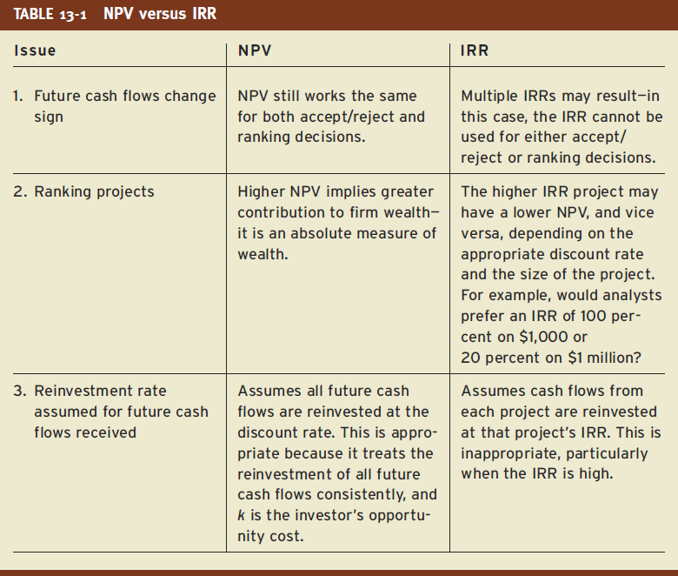
NPV vs IRR
Notes:
2) NPV will tell you which project adds more value to the firms
Using IRR, the higher IRR may have a lower NPV but depending on the size of the project

Slide 19
Unequal years Problem: Equivalent Annual Costs
We are looking at purchasing a new machine. We have narrowed our search down to Machine A and Machine B.
A B
Initial Cost 500 600
Annual costs 120 100
Life of machine 3 yrs 4yrs
Discount rate = 10%
Assumptions: The machine chosen will be replaced indefinitely and neither machine will have a differential impact on revenue.
Which machine should we purchase?
Notes:
Note that this is a COST example.

Slide 20
Problem: Equivalent Annual Costs cont.
PV_{A} = $798.42
PV_{B} = $916.99
Calculate the EAC: Solve for “PMT” of an annuity, with a discount rate of 10%, i.e.:
For A: What 3 annual payments would give us a PV of $798.42?
Use formula or your calculator…
(Note: This is also known as the Equivalent Annual NPV “EANPV” approach)
Notes:
For A:
PV = 798.42 FV = 0 i = 10% N = 3 yrs
PMT = ?
So, PMT = 321.06
Using the formula: PV = C/r [1-(1+r)^{-n}]
For B:
PV = 916.99
N = 4 yrs
Everything else the same.
So, PMT = 289.28
Therefore choose B as the EAC is lower.

Slide 21
Payback Period
The payback period:
Simple approach
Tells you how many years it will take to recover the initial investment
Often used as one of a set of investment screens, because it gives the manager an intuitive sense of the project’s risk
The discounted payback period:
Calculate the PV of future cash flows, and use these to see how long you get your initial money back
Overcomes the lack of consideration of time value of money that is lacking in the simple payback period
Problem: Doesn’t consider cashflows after the cut-off
Notes:
Reminder: the further the revenues are, the more risky they are too.
Private equity they will say they don’t want to look at a project that they will get their money back after 3 years. Want it within a certain time
Suppose there is a project where there is a Poor cash flows for the first 4 years but there is a huge cash flow that happens in year 5. Want to sometimes calculate what the present value of those cashflows are now.
They don’t look at projects after the cutoffs even though the cash flow may happen late

Slide 22
Problem: Payback Period
Example: Determine the payback and discounted payback (with a 10% discount rate) for a project that costs $100,000 to implement and gives $60,000 after-tax cash flows for six years
Year | CF | Discounted CF
0 | -$100,000 | -$100,000
1 | $60,000 | $54,545
2 | $60,000 | $49,587
3 | $60,000 | $45,079
4 | $60,000 | $40,981
5 | $60,000 | $37,255
6 | $60,000 | $33,868
Notes:
Solution:
Payback period is 1.7 years
Y1: full,
Y2: 40/60
Discounted payback period is 1.9 years
Y1: full 54,545 needed.
Y2 need 45,455 to make up 100,000 and have 49,587, so need 0.9 (45,455 / 49,587)

Slide 23
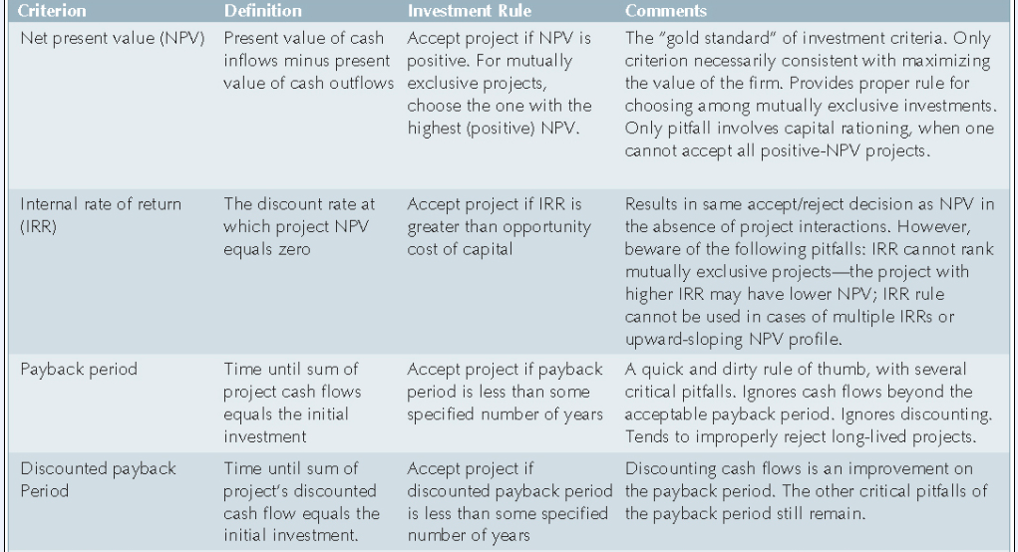
Summary of evaluation criterion
Source: Brealey et al, Fundamentals of Corporate Finance, 4th ed.

Slide 24
Capital Rationing
What?
Capital rationing: Companies often limit the amount of funds dedicated to capital investments in any one year
Why?
Owners don’t want to issue more shares if it dilutes their stake
The firm doesn’t have short-term managerial capacity to oversee the projects

Slide 25
Capital Rationing
Implications:
It is academically illogical: why would a manager not invest in a project that will offer a greater return than the cost of capital used to finance it?
In the long-run, capital rationing could threaten a firm’s continuing existence through the erosion of its competitive position
Under capital rationing the cost of capital is no longer the appropriate opportunity cost
IRR may have more validity because the firm may be able to reinvest its cash flows at rates that are higher than the cost of capital

Slide 26
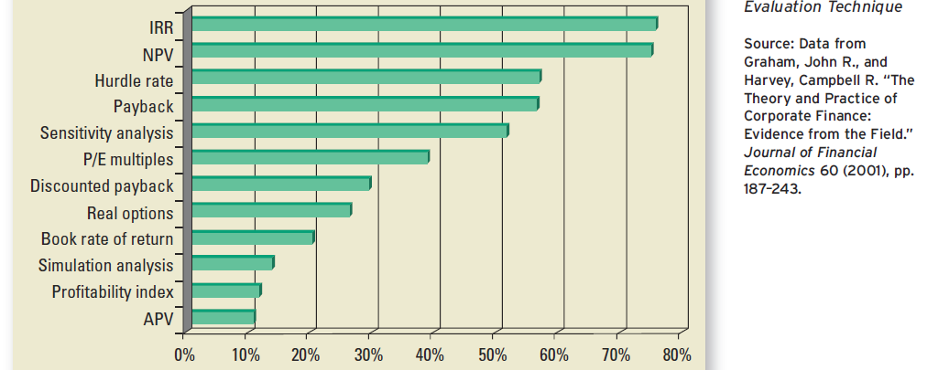
CFO Preferences
Despite the inherent superiority of the NPV approach, chief financial officers continue to use other approaches and do not necessarily favour NPV over IRR
Perhaps the reason for this is that it is difficult for people to understand what a positive NPV really means

Slide 27
Objectives
Calculate Net Present Value (NPV) and Payback Period
Explain the calculation of Internal Rate of Return (IRR)
Distinguish between IRR and NPV, and interpret the results of calculations
To understand and interpret IRR:
Compare to cost of capital
Draw a basic graph of NPV profiles and show the IRR’s for two projects
Understand the NPV / IRR issues
Understand other Capital budgeting decision rules

Slide 28
Forthcoming attractions
Tutorial today: 16h00 – 17h00
Next week: Ch 6 – Bonds
Quiz 1:
Thurs, Oct 10, 2019 (16h10 – 17h00 => during tutorial)
To cover material from lectures 1 to 4

